Slide 1
Checking for Collisions: Validating Optimality/Feasibility
Supervisor: Pieter Collins
Group 14

Slide 2

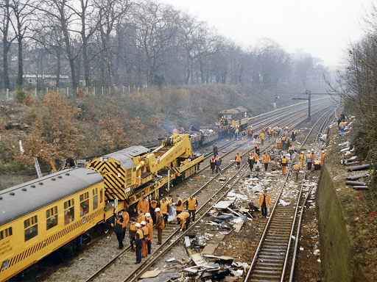
Motivation: Safety-critical systems
Detect collisions BEFORE they happen

Slide 3
Approximate vs Rigorous Algorithms
Rigorous:
Pros: Finds correct exact solution
Cons: Requires a lot of time
Approximate:
Pros: Faster computation
Cons: Closeness or even existence of real solution not certain
Combining the two?
Rigorously verifying whether an exact solution exists close to an approximation, is faster than finding the solution

Slide 4
Can we validate a given approximation by proving the existence of a real solution 'nearby'?
Research question

Slide 5
Concepts and Approach
Approach:
Combining approximate and rigorous algorithms
Tools:
Ariadne
Intlab

Slide 6
Concepts and Approach
Interval arithmetic
Newton method
Interval Newton method
Karush–Kuhn–Tucker (KKT) conditions
Milestone:
Solving one-dimensional (single variable) equations

Slide 7
Interval Arithmetic
Technique for doing a rigorous calculations
Number is represented by an interval - lower and upper bound
Classical operations of real arithmetic can be used on intervals
Notes:
Martini

Slide 8
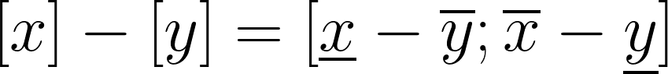
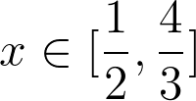
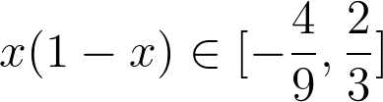
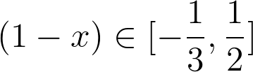
Example
Difference between the two intervals:
Product of two intervals:

Slide 9
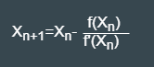
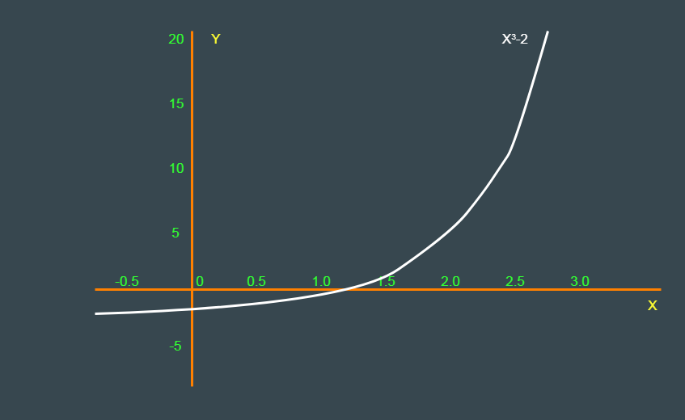
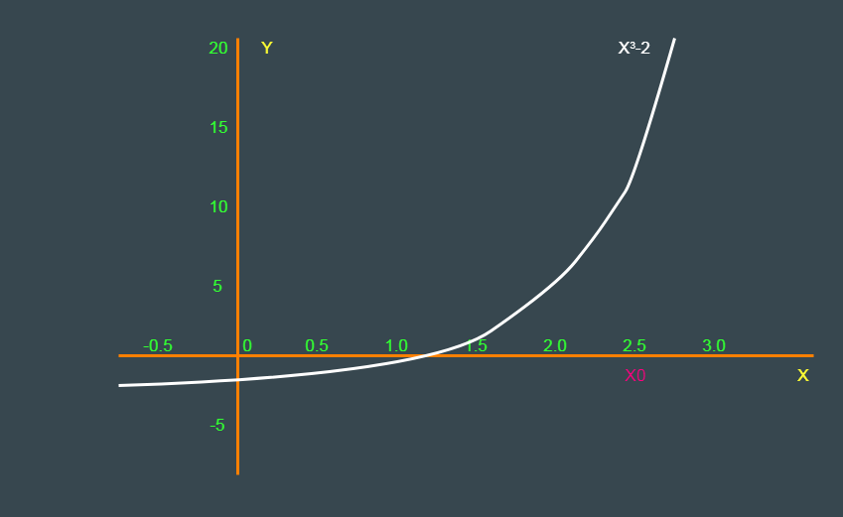
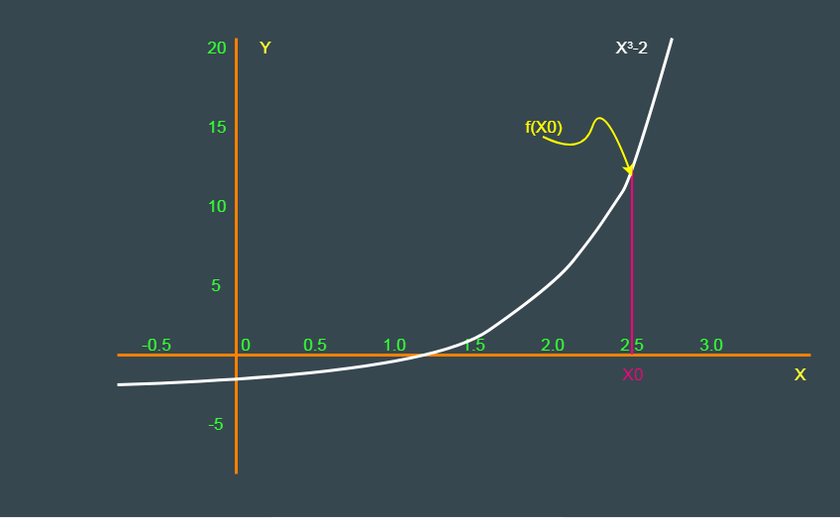
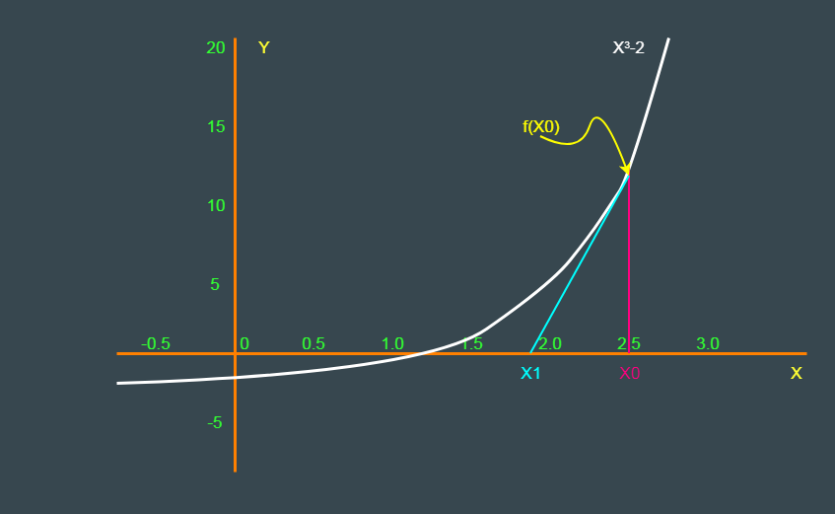
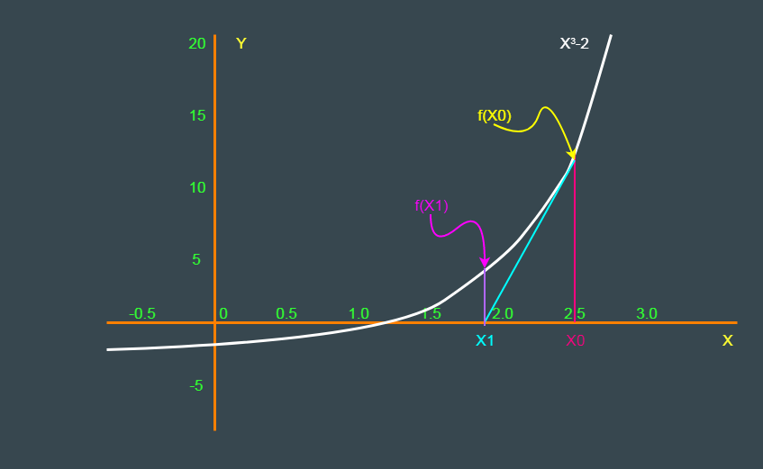
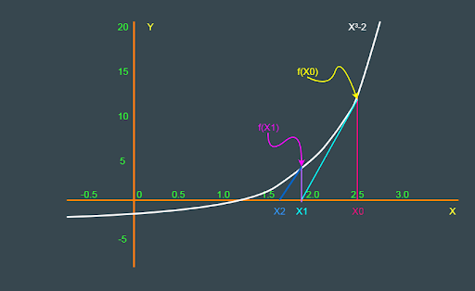
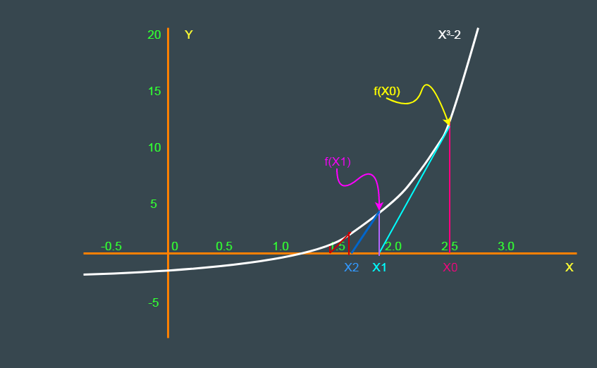
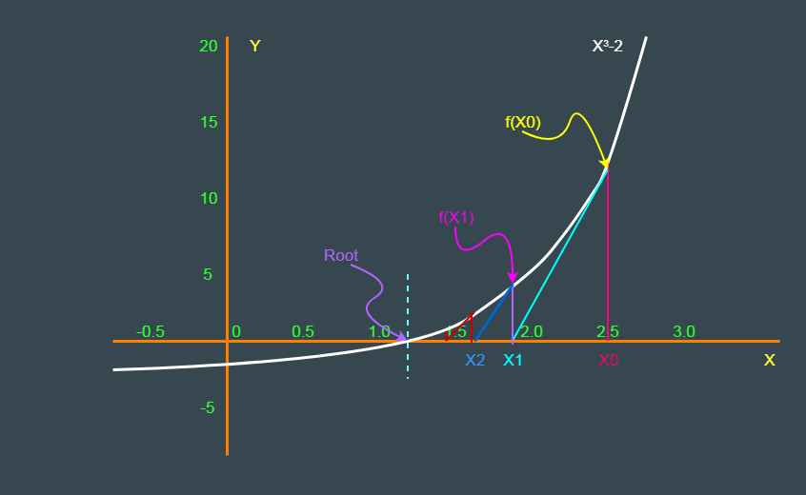
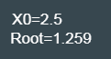
Newton Method
Notes:
Tahmina: Root?
Initial value of x is x0
(no mathematical explanation)

Slide 10
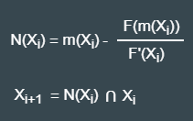

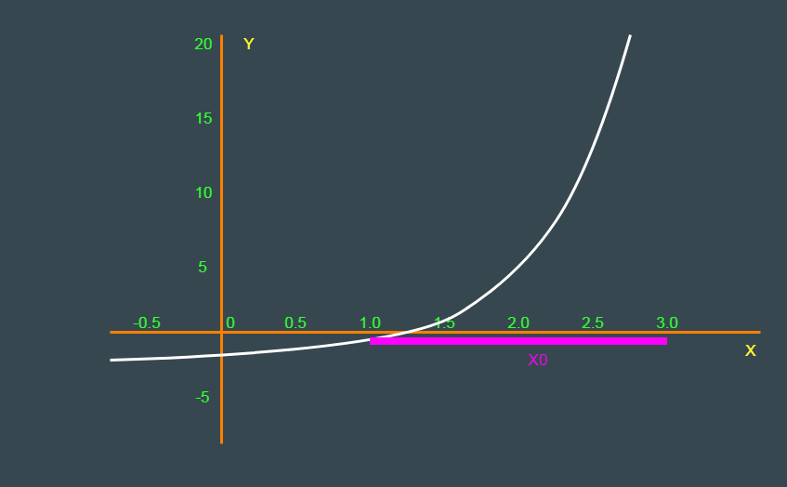
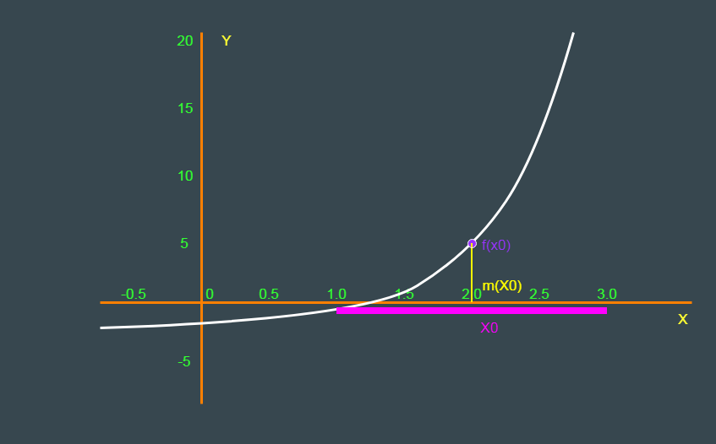
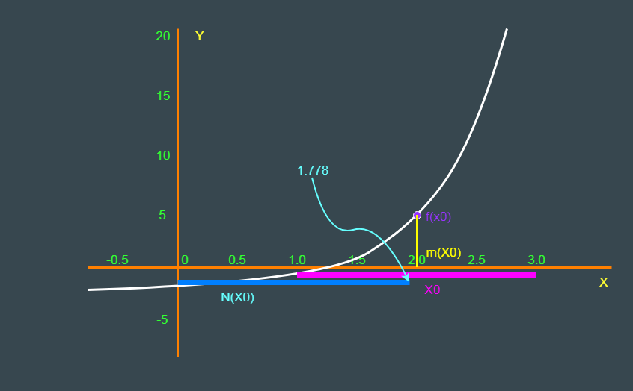
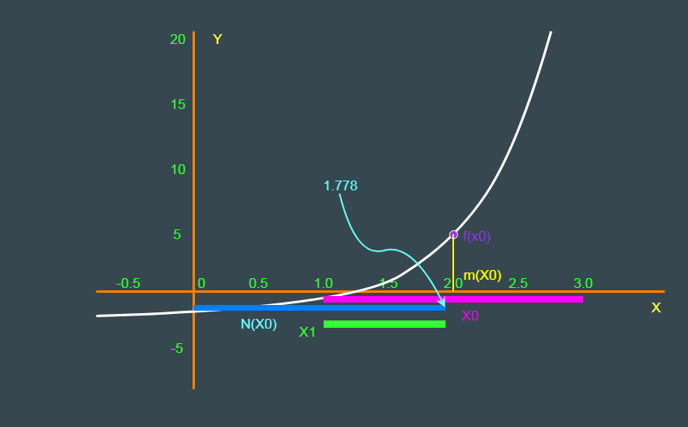
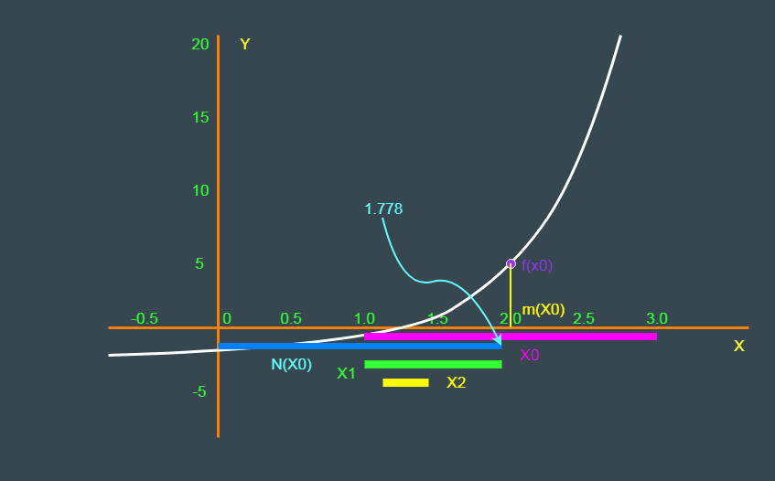
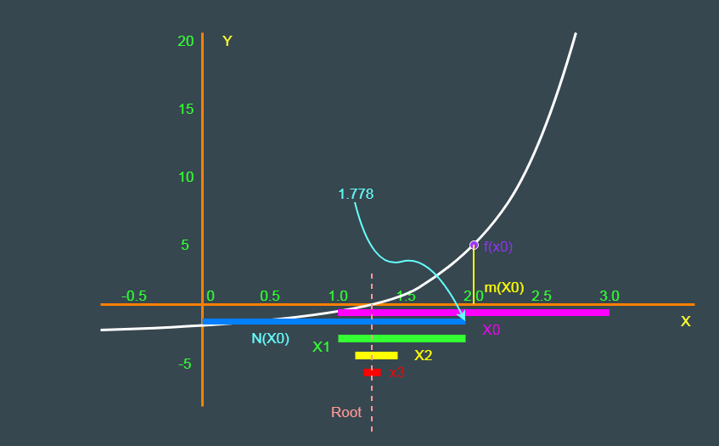
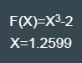
Interval Newton Method
Notes:
Tahmina:
Initial value of x is x0[1.0,3.0]
Newton value of X0

Slide 11
Newton Method and Interval Newton Method
Notes:
Comparison:
iterative process,
robust, faster and simple methods
Interval?
find the initial estimator/box, x0

Slide 12
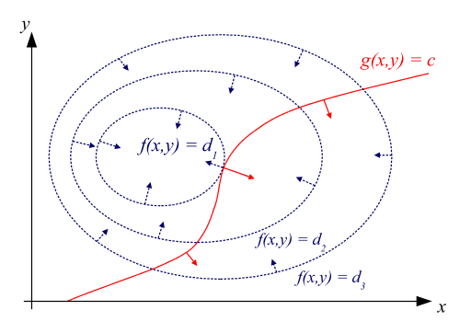
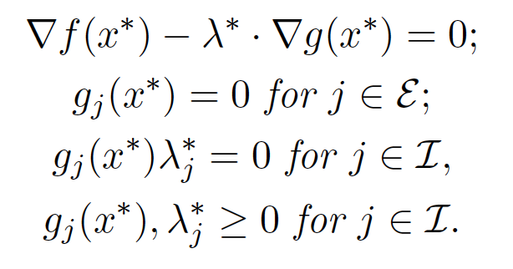
Optimality/feasibility Conditions
Karush-Kuhn-Tucker conditions check for optimality and feasibility
Based on Lagrange multipliers
Optimality is reached when,
Notes:
casper

Slide 13
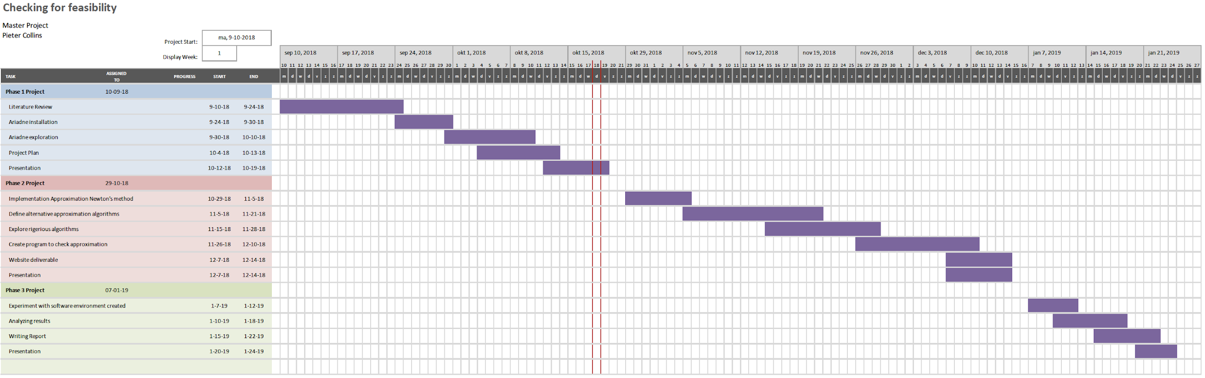
Time Management
Notes:
casper

Slide 14
Risk Analysis
General Risks Involved:
Approximation too far from real solution
Infeasibility (no real solution)
Minimizing those: start off with 1-dimensional problems
Additional risk: no efficient algorithms beyond 1 dimension
Notes:
edwin

Slide 15
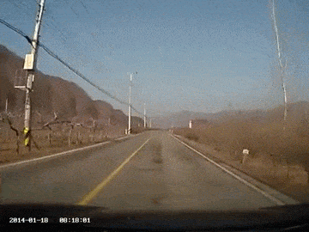
Social Impact & Conclusion
Rigorous vs Approximate
More confidence in safety-critical systems

Slide 16
Questions?

